Slide 1
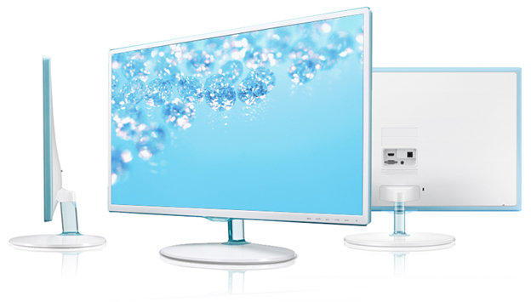
History of Computer Display Screens
By: helal hAidari

Slide 2
History of display screens?
Cathode ray tubes became the first computer monitors that people used to view computer information.

